Slide 1
Presentation to MHEC MACC’s Fiscal Requests to 2021 Legislature
Dr. Bernard J. Sadusky,
MACC Executive Director
Presenter-Dr. Brad Phillips
September 23, 2020

Slide 2
Legislative Fiscal Requests
Funding Facilities Renewal Grant
Restoration
Full Capital Project Funding
Streamline Transfer Process
Full Cade Funding

Slide 3
FY 2022 CADE Funding
Help the State understand the lessons from the last economic downturn.
In order for Maryland to recover – the workforce must be trained for the evolving needs of returning to work during and after a global pandemic.
MACC seeks 27% formula tie as prescribed by law.
Estimated request this year = $29.8M or 11.9%.
MACC seeks full funding of BCCC’s formula for FY 22.

Slide 4
Capital Project Funding
Aggregate Weight | Community College | Community College | Project Name | Project Phase | Project Cost
Preauthorized Split Funded Projects from FY 2021 | Allegany College of Maryland | Allegany College of Maryland | Technology Building, Project 2 | Construction | $ 2,918,000
 | Cecil College | Cecil College | Entrance Roadway & Facilities Maintenance Building | Construction | 3,507,000
 | Frederick Community College | Frederick Community College | Linganore Hall (Building L) Renovation/Addition | Construction | 3,132,000
 | Howard Community College | Howard Community College | Mathematics & Athletics Complex | Construction | 13,844,000
 | Montgomery College | Montgomery College | Catherine and Isiah Leggett Math and Science Building | Construction | 12,569,000
 | Prince George's Community College | Prince George's Community College | Marlboro Hall Renovation and Addition | Construction | 30,846,000
Preauthorized Total |  |  |  |  | $ 66,816,000
1 | Cecil College | Cecil College | Campus Entrance/Roadway & Facilities Management Building | Completion | $ 270,000
2 | Frederick Community College | Frederick Community College | Linganore Hall Building | Completion | 179,000
3 | Montgomery College | Montgomery College | Math & Science Center | Completion | 4,500,000
4 | Prince George's Community College | Prince George's Community College | Marlboro Hall | Completion | 2,224,000
5 | Wor-Wic Community College | Wor-Wic Community College | New Applied Technology Building | Construction | 22,925,000
6 | Harford Community College | Harford Community College | Chesapeake Welcome Center | Design+ | 4,186,000
7 | College of Southern Maryland | College of Southern Maryland | HT Renovation | Design+ | 1,894,000
8 | Community College of Baltimore County | Community College of Baltimore County | Wellness & Athletics Center | Design+ | 4,150,000
9 | Hagerstown Community College | Hagerstown Community College | Learning Resource Center Exterior | Design+ | 1,175,000
10 | Prince George's Community College | Prince George's Community College | Largo Student Center Renovation | Construction | 5,374,000
11 | Community College of Baltimore County | Community College of Baltimore County | Student Services Renovation | Design | 250,000
12 | Community College of Baltimore County | Community College of Baltimore County | Storm Water Management Compliance | Design+ | 425,000
13 | Prince George's Community College | Prince George's Community College | Bladen Hall Renovation | Design | 827,000
 |  |  |  |  | $ 48,379,000
Total FY 2022 Request |  |  |  |  | $ 115,195,000

Slide 5
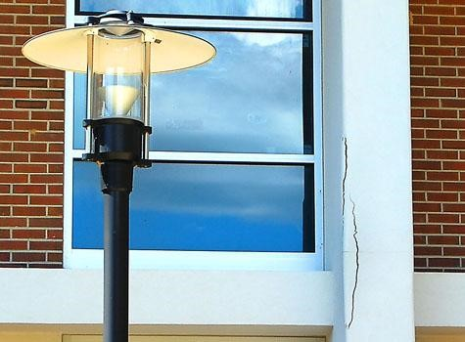
Facilities Renewal Grant
8 Colleges approved “alternate years”
5% of Capital Budget
Up to $500K/ College
Restoration of $2.8 M recission from FY20 Grant
Restoration of Program $4M for eligible institutions
47% White

Slide 6
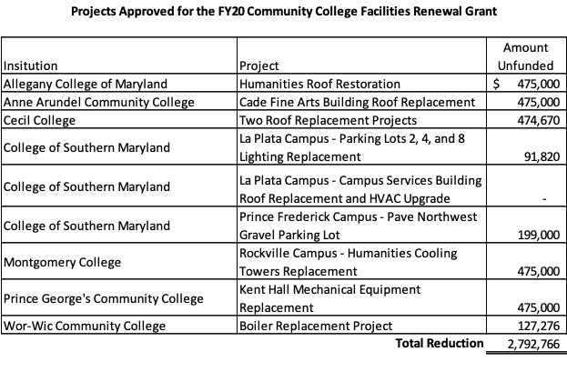
Facilities Renewal Grant

Slide 7
Streamline Transfer Process
MACC SEEKS:
Annual reporting requirements from public institutions of higher education to MHEC on denials of transfer credit and courses for MD students with explanation of denial.
An annual summary on transfer credit and course denials from MHEC with recommendations for transfer improvement to the Governor and the General Assembly.
Third-year with junior status classification for any MD community college student transferring t0 any public four-year institution with an A.A or A.S degree who earned 60 credit hours.

Slide 8
Streamline Transfer Process
MACC SEEKS:
Acceptance of courses taken by a student as a general education course at a MD community college to transfer seamlessly, without further review, as meeting the general education requirements of the receiving public four-year institution.
All courses completed at a MD community college following the recommended transfer programs at a four-year institution be accepted and applied to that program by the four-year institution.
Collaboration with USM for the development of course outcomes for general education courses and courses required for recommended transfer degree programs.
Seek State support in funding an update to ARTSYS that would reflect the nature and movement of students throughout their higher education experience.

Slide 9
Universal FAFSA Filing
Several states require all high school seniors to submit FAFSA
Completing FAFSA form is a predictor of college enrollment
Exemptions allowed – creating a system where students opt out.
MACC supports legislation requiring high school seniors to complete FAFSA.

Slide 10
Contact Information
Maryland Association of Community Colleges
60 West Street Suite 200
Annapolis, Maryland, 21401
Bernard J. Sadusky, Ed.D.
Executive Director
bsadusky@mdacc.org
410-974-8117
www.mdacc.org

